Slide 1
Classification and Classifiers Overview
Types Of Classification
k-NN, SVM, Decision Trees
Strengths, Weaknesses & Picking the Right Model

Slide 2
What is Classification?
Classification teaches a machine to sort things into categories.
It learns by looking at examples with labels (like emails marked "spam" or "not spam").
After learning, it can decide which category new items belong to, like identifying if a new email is spam or not.
Examples: spam detection, disease diagnosis, object recognition

Slide 3
Types of Classification
There are different types of classification problems depending on how many categories (or classes) we are working with and how they are organized.
There are two main classification types in machine learning:
1. Binary Classification
2. Multiclass Classification

Slide 4
Binary Classification
In binary classification, the goal is to sort the data into two distinct categories.
Think of it like a simple choice between two options.
Imagine a system that sorts emails into either spam or not spam.
It works by looking at different features of the email like certain keywords or sender details, and decides whether it’s spam or not. It only chooses between these two options.

Slide 5
Multiclass Classification
Here, instead of just two categories, the data needs to be sorted into more than two categories. The model picks the one that best matches the input.
Think of an image recognition system that sorts pictures of animals into categories like cat, dog, and bird.
Basically, machine looks at the features in the image (like shape, color, or texture) and chooses which animal the picture is most likely to be based on the training it received.

Slide 6
Multi-Label Classification
In multi-label classification single piece of data can belong to multiple categories at once.
Unlike multiclass classification where each data point belongs to only one class, multi-label classification allows datapoints to belong to multiple classes.
A movie recommendation system could tag a movie as both action and comedy.
The system checks various features (like movie plot, actors, or genre tags) and assigns multiple labels to a single piece of data, rather than just one.

Slide 7
Classification Algorithms
Now, for implementation of any classification model it is essential to understand Logistic Regression, which is one of the most fundamental and widely used algorithms in machine learning for classification tasks.
There are various types of classifiers algorithms. Some of them are :
Linear Classifiers
Non-linear Classifiers

Slide 8
Linear classifier
Linear classifier models create a linear decision boundary between classes.
They are simple and computationally efficient.
Example:
Logistic Regression
Support Vector Machines having kernel = 'linear'
Single-layer Perceptron
Stochastic Gradient Descent (SGD) Classifier

Slide 9
Non-linear Classifiers
Non-linear models create a non-linear decision boundary between classes.
They can capture more complex relationships between input features and target variable.
Examples:
K-Nearest Neighbours
Kernel SVM
Naive Bayes
Decision Tree Classification
Ensemble learning classifiers
Random Forests
AdaBoost
Voting Classifier

Slide 10
What is KNN?
A supervised machine learning algorithm.
Lazy learner — no explicit training.
The algorithm simply stores the entire training dataset (features + labels).
Classify a new point by majority vote of its k nearest neighbors in feature space.
Uses a distance metric (e.g., Euclidean, Manhattan).
Non-parametric & instance-based.​
It does not assume any fixed mathematical form (like a line or curve) for the data.
It doesn’t have a fixed number of parameters that describe the model.
The algorithm memorizes training examples instead of learning a general rule.
When a new sample comes, it compares it with stored instances to make a prediction.

Slide 11
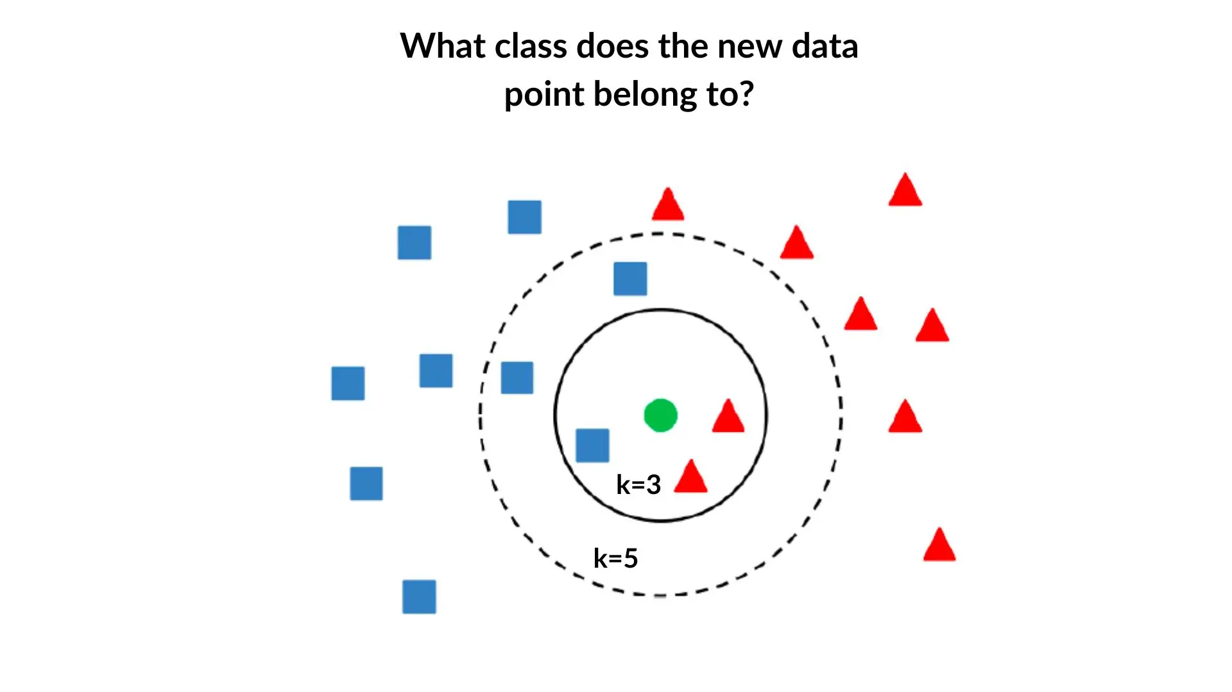
K-NN Classification

Slide 12
How Does KNN Work?
Given a new data point:
KNN looks at k-nearest neighbors.
Assigns label/class based on the majority (classification) or average (regression).
Distance Metrics in KNN
Euclidean Distance (√∑(x_{i}−y_{i})²)
Manhattan Distance (∑ |(x_{i}−y_{i})|)

Slide 13
‘k’ in KNN?
The number of neighbors to consider (k).
Odd values often used to avoid ties.
Choosing k is critical:
Large k: too simple (underfitting).
Small k: more sensitive to noise.
Choosing the Value of k
Cross-Validation: Test multiple k, select with best accuracy.
Elbow Method: Plot error rate vs. k, pick the “elbow” point.

Slide 14
Steps of the KNN Algorithm
Choose k.
Calculate distance from target to all dataset points.
Find k closest neighbors.
Predict:
Most common class (classification).
Average (regression).

Slide 15
k-NN - Strengths & Weaknesses
Strengths:
Simple, intuitive, no training phase
Works well for small, low-dimensional data
Weakness:
Slow for large datasets (distance computation)
Does not scale well
High storage
Curse of dimensionality (in high dimensions hard to find neighbors, data points become sparse)
Sensitive to irrelevant or unscaled features

Slide 16
Support Vector Machine (SVM)
SVM is a supervised machine learning algorithm used for classification and regression.
It finds the best boundary (hyperplane) that separates classes in data.
Common uses: spam vs. not spam, cat vs. dog classification.

Slide 17
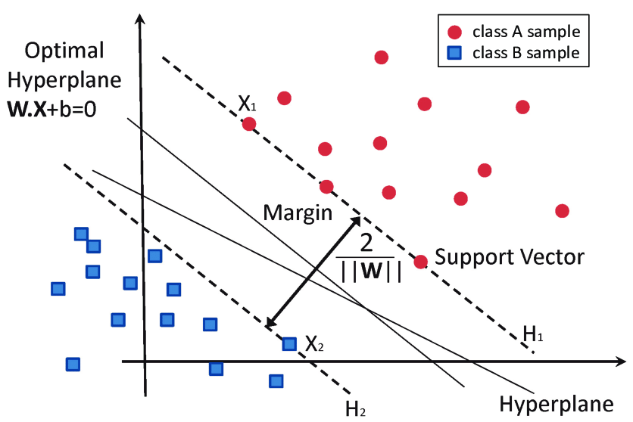
SVM

Slide 18
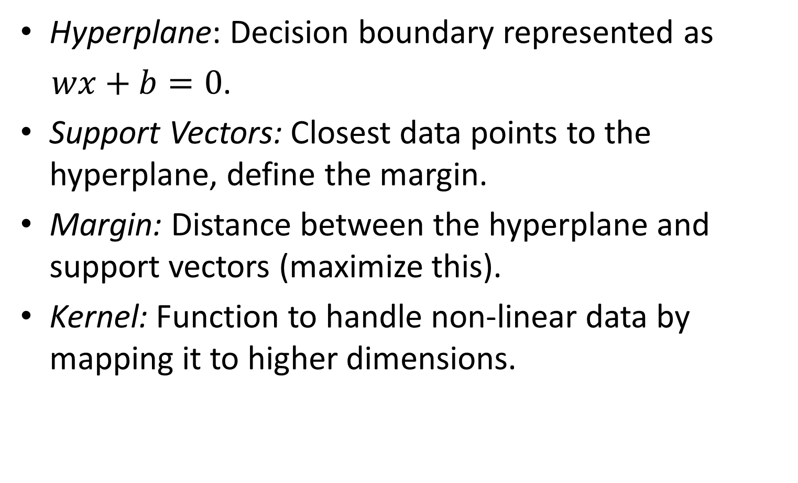
Key Concepts
Hyperplane: Decision boundary represented as
$wx+b=0$.
Support Vectors: Closest data points to the hyperplane, define the margin.
Margin: Distance between the hyperplane and support vectors (maximize this).
Kernel: Function to handle non-linear data by mapping it to higher dimensions.

Slide 19
Soft Margin: Allows some misclassification, balances errors and margin width.
Balances between maximizing margin and minimizing classification errors.
Introduces a penalty for violating the margin — controlled by parameter C.
Hard Margin: Perfect separation, no misclassifications.
Works only if data is completely separable.
Very sensitive to noise or outliers (a single wrong point can distort the boundary).
C (Regularization Term): Controls trade-off between margin and classification errors.
C controls the trade-off between margin width and error tolerance:
Large C → model focuses on classifying all points correctly (narrow margin, risk of overfitting)
Small C → allows more errors for a smoother, wider margin (better generalization)
Hinge Loss: Loss function penalizing margin violations.
If a point is correctly classified and far from the margin → loss = 0
If it’s inside or on the wrong side of the margin → loss increases linearly

Slide 20
How Does SVM Work?
SVM finds a hyperplane that maximizes the margin between two classes.
Supports outliers by ignoring or softly penalizing them.

Slide 21
SVM with Non-Linearly Separable Data
When data isn't linearly separable, kernels are used.
Kernel Trick: Maps data to higher dimensions to make it separable.
Examples: Linear, Polynomial, RBF kernels.

Slide 22
SVM - Strengths & Weaknesses
Strengths:
Performs well in high-dimensional spaces.
Handles nonlinear data with kernels.
Robust to outliers with soft margin.
Supports binary and multiclass classification.
Efficient memory usage.
Weakness:
Slow training on large datasets.
Choosing right kernel & parameters can be tricky
Sensitive to noise and scaling of features.
Less interpretable than simpler models.

Slide 23
Decision Tree - Concept
Tree-structured model that splits data based on feature conditions
Used in machine learning for classification and prediction
Splits chosen using Information Gain or Gini Index
Example: If Age < 18 → Student, Else If Income > 50k → Professional

Slide 24
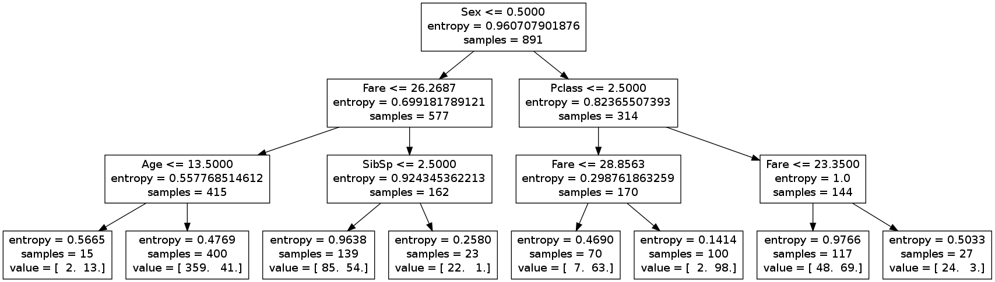
Decision Trees

Slide 25
Structure of a Decision Tree
Root Node: Represents the whole dataset
Branches: Show flow from one decision to another
Internal Nodes: Decision points based on features
Leaf Nodes: Final decision or prediction
Decision Trees naturally keep splitting until every leaf is pure (all samples belong to one class).

Slide 26
Types of Decision Trees
Classification Trees: Predict categorical outcomes (e.g., spam/not spam)
Regression Trees: Predict continuous outcomes (e.g., house prices)

Slide 27
How Decision Trees Work
Start with a root question
Ask yes/no questions to split data into subsets
Branching continues until reaching a leaf node (final prediction)

Slide 28
Splitting Criteria
Gini Impurity: Measures how well a feature distinguishes between categories
Entropy: Measures uncertainty/disorder; reduces by splitting on informative features
We need to find a state that gives minimum entropy
Model traverses every possible feature and feature value to find the best split.
Decision tree is a greedy algorithm:
Not guarantee optimal splits
Future splits depend upon previous splits

Slide 29
Pruning in Decision Trees
When a tree is grown deeply, it can memorize training data (overfitting).
Pruning helps it focus only on the most important splits that generalize well to new data.
Removes branches with little predictive power.
Helps tree generalize better, improving performance on new data
Makes the model simpler and faster
Types:
Pre-pruning
Post-pruning

Slide 30
Decision Tree - Strengths & Weaknesses
Strengths:
Easy to interpret & visualize
Handles numeric & categorical data
Weakness:
Prone to overfitting if not pruned
Unstable to small data changes

Slide 31
K-NN use cases
Use Case | Why k-NN Works Well
Recommendation Systems (e.g., similar users/items) | Finds similarity between users or products naturally
Pattern recognition / image classification (small dataset) | Local similarity in features → accurate classification
Anomaly or outlier detection (small-to-medium data) | Distance-based detection of “unusual” points
Medical diagnosis with few samples (e.g., k-NN on lab results) | Works well when number of features is moderate and structure is clear

Slide 32
SVM Use Cases
Use Case | Why SVM Works Well
Text classification (spam, sentiment, news categorization) | High-dimensional sparse features; linear SVM performs excellently
Image recognition (e.g., face vs. non-face) | Can capture complex boundaries with RBF kernel
Bioinformatics / gene expression data | Few samples, many features → SVM handles this well
Handwriting or digit recognition (MNIST-scale) | RBF kernel separates curved, complex boundaries
Small–medium tabular data with clear separation | Margin-maximization gives robust results

Slide 33
Decision Tree Use cases
Use Case | Why Decision Tree Works Well
Business decision modeling (e.g., loan approval, churn prediction) | Easy to interpret — “if-else” rules understandable by non-experts
Medical diagnosis and risk assessment | Visual and interpretable logic (e.g., “if BP>140 and Age>50 → high risk”)
Customer segmentation / marketing analytics | Handles mixed numeric + categorical features
Fraud detection (with class imbalance) | Handles non-linear relationships and variable interactions
As base model for Random Forest / Gradient Boosted Trees | Forms the foundation of ensemble methods

Slide 34
Comparison of Classifiers
k-NN → Lazy learner, sensitive to scale
SVM → Strong margins, works well in high dimensions
Decision Tree → Intuitive, may overfit
Feature scaling needed: k-NN & SVM (Yes), Decision Tree (No)

Slide 35
Comparison Table
Criterion | k-NN | SVM | Decision Tree
Data size | Small–Medium | Small–Medium | Small–Large
Feature type | Numeric (scaled) | Numeric / text (sparse OK) | Numeric + Categorical
Interpretability | Medium | Low | High
Training time | Very fast | Medium–High | Fast
Prediction time | Slow | Medium | Fast
Handles Non-linear patterns | Moderate (via distance) | Excellent (via kernel) | Good
Works with high-dimensional data | Poor | Excellent | Fair
Best suited for | Similarity-based problems | Clear margin or high-dimensional problems | Human-interpretable rule-based problems

Slide 36
When to use which one?
Small dataset + simple boundaries → k-NN
Complex but clean data + margin separation → SVM
Need explainability → Decision Tree
Many categorical features → Decision Tree
Very large dataset → Tree-based ensembles or Logistic Regression
Noisy or high-dimensional → Avoid k-NN

Slide 37
Practical Tips
Always scale features for k-NN and SVM
Use cross-validation to tune hyperparameters (k, kernel, tree depth)
Compare using ROC-AUC or F1-score (not just accuracy)
Combine models → e.g., Random Forest (many trees), Voting Classifiers

